Slide 1
CAR PRICE PREDICTION
By Kartik Krishna

Slide 2
Problem Statement
With the covid 19 impact in the market, we have seen lot of changes in the car market. Now some cars are in demand hence making them costly and some are not in demand hence cheaper. One of our clients works with small traders, who sell used cars. With the change in market due to covid 19 impact, our client is facing problems with their previous car price valuation machine learning models. So, they are looking for new machine learning models from new data. We have to make car price valuation model.

Slide 3
Business Goal
You have to scrape used cars data from sites like olx, cars24, cardekho, etc.
You are required to model the price of cars with the available independent variables. This model will then be used by the management to understand how exactly the prices vary with the variables. They can accordingly manipulate the strategy of the firm and concentrate on areas that will yield high returns. Further, the model will be a good way for the management to understand the pricing dynamics of a new market.

Slide 4
About Dataset
Data was collected from olx.in.
Data contains 2240 entries each having 11 variables.
Data contains Null values.
Data contains numerical as well as categorical variable.

Slide 5
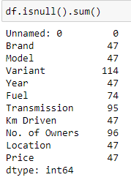
Null Values
There are many missing values present in the dataset. For the treatment of missing values, all the rows with missing values were dropped.
After dropping missing values the shape of the dataset changed to (2063, 11).

Slide 6
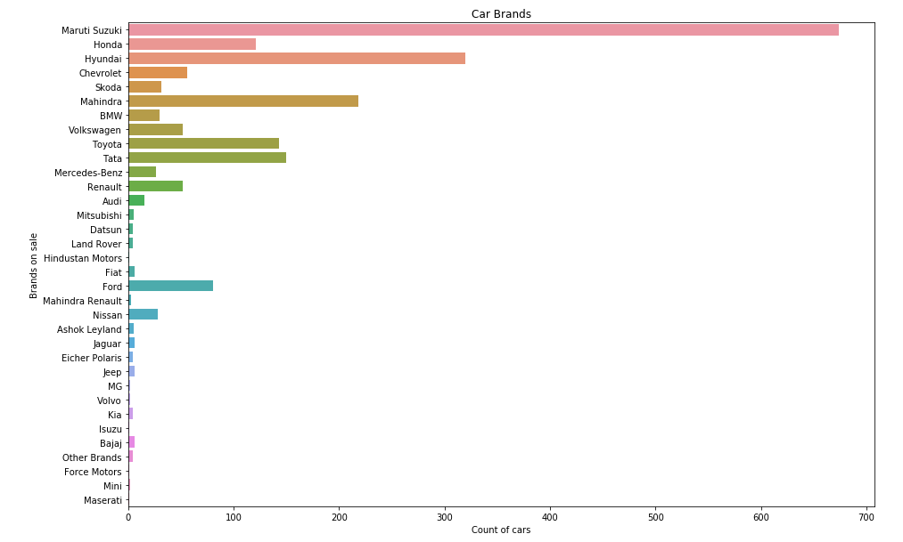
EDA
This is the countplot for one of the variable, Brand.
As we can see, Maruti Suzuki has the highest count, followed by Hyundai.

Slide 7
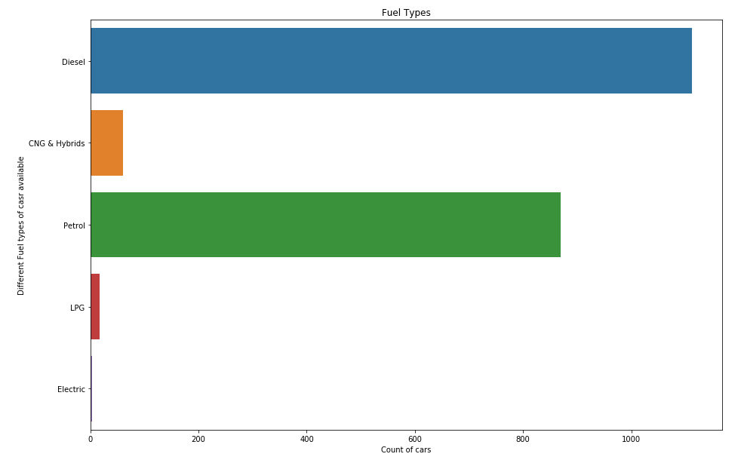
EDA
This is the countplot for one of the variable, Fuel Types.
As we can see, Diesel has the highest count, followed by Petrol.
While Electric has the least value.

Slide 8
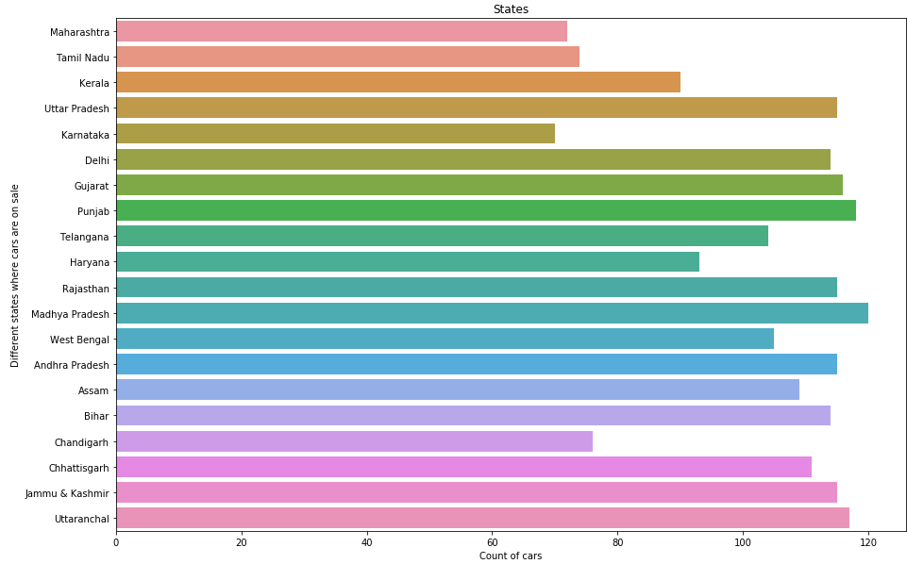
EDA
This is the countplot for one of the variable, States.
As we can see, the data in this graph is well spread. Madhya Pradesh seems to have highest count while Karnataka has the lowest count among them.

Slide 9
EDA
This is the countplot for one of the variable, Brand.
As we can see, Maruti Suzuki has the highest count, followed by Hyundai.

Slide 10
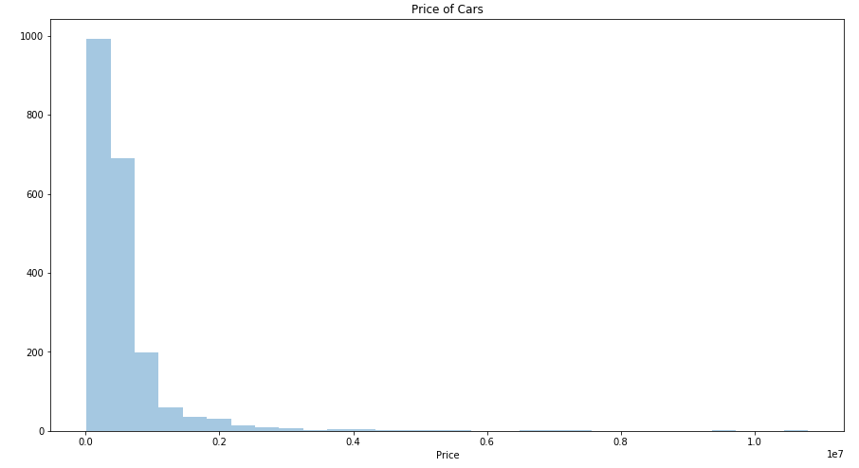
EDA
This is the distplot for the target variable, Price.
As we can see, almost all of the data is below 20 lakhs and most of it is below 10 lakhs.

Slide 11
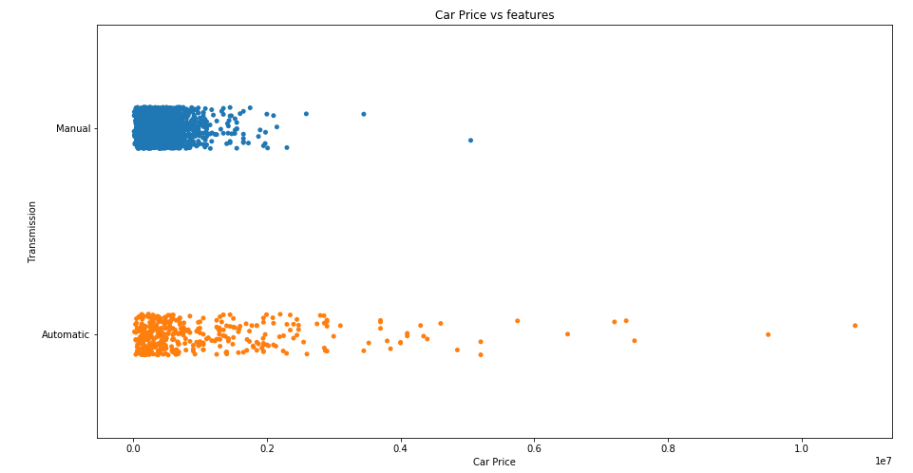
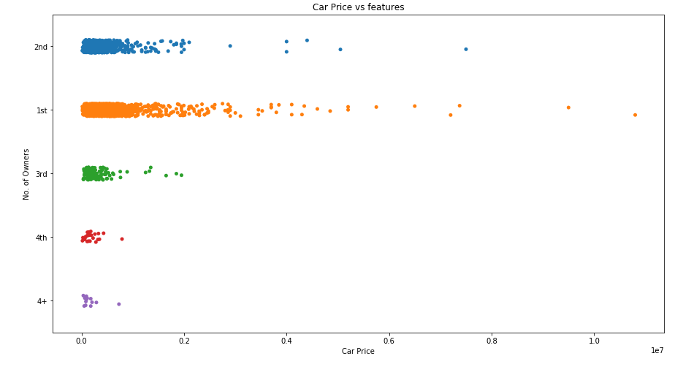
Bivariate Analysis
The following graphs are strip plots representing the relationship between car price and various features like transmission and number of previous owners.

Slide 12
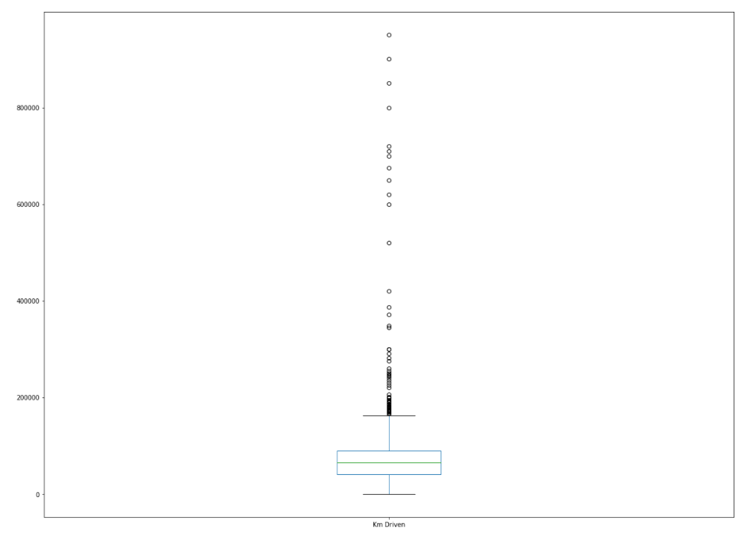

Outliers and Skewness

Slide 13
Continue...
The boxplot in the previous slide is of Km Driven, in the plot we can see there are many outliers present in the data. The other picture is of the skewness present in the dataset. As we can see, the column have skewness over the accepted value of +-0.5.
Instead of extensively treating for outliers, we will only treat the skewness present in the data, using both of log and square root transformation. After treatment the outliers will also drop significantly.
Square root transformation gave as better results hence we will implement that only.

Slide 14
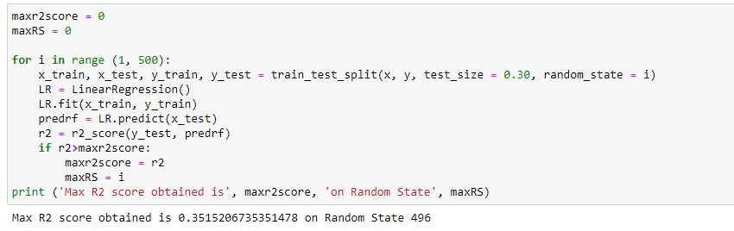
Model Building
The first thing we will do is get the best random state, for train test split. We will do this with the help of a simple linear regression model.
The best R2 score for linear regression we obtained is 0.351.

Slide 15
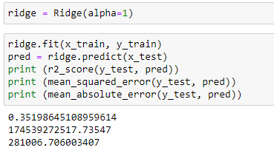
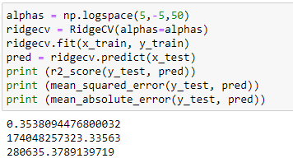
Ridge and RidgeCV
R2 score for L2 regularization for alpha = 1 is 0.351, but after using different alpha values our R2 score also increased to 0.353.
RidgeCV is just ridge regression with inbuilt cross validation, so we don’t have to find the cross validation score extensively.

Slide 16
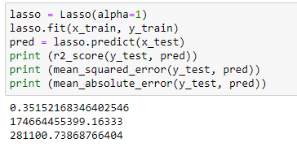
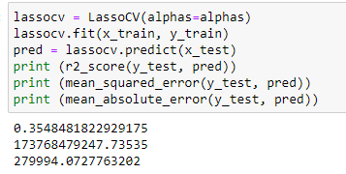
Lasso and LassoCV
We already got improved score after using ridge regression.
Our R2 score L1 regularization for alpha = 1 is 0.351, but after using different alpha values our R2 score also increased to 0.354.
LassoCV is just lasso regression with inbuilt cross validation, so we don’t have to find the cross validation score extensively.

Slide 17
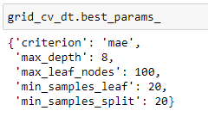
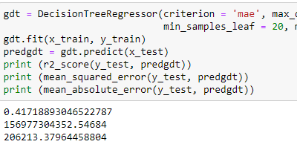
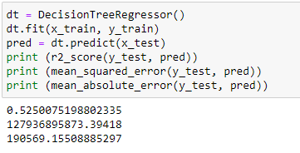
Decision Tree Regressor
R2 score with decision tree regressor increased to 0.525, but after hypertuning the score dropped to 0.417.
The best parameters we got after gridsearchcv can be seen in the image.

Slide 18
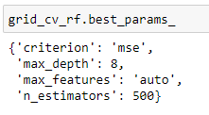
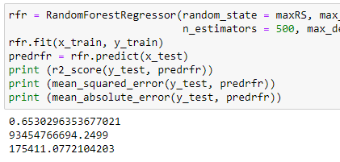
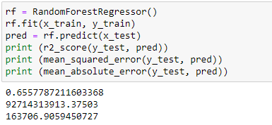
Random Forest Regressor
R2 score with random forest regressor increased to 0.656, but after hypertuning the score reduced to 0.653.
The best parameters we got after gridsearchcv can be seen in the image.

Slide 19
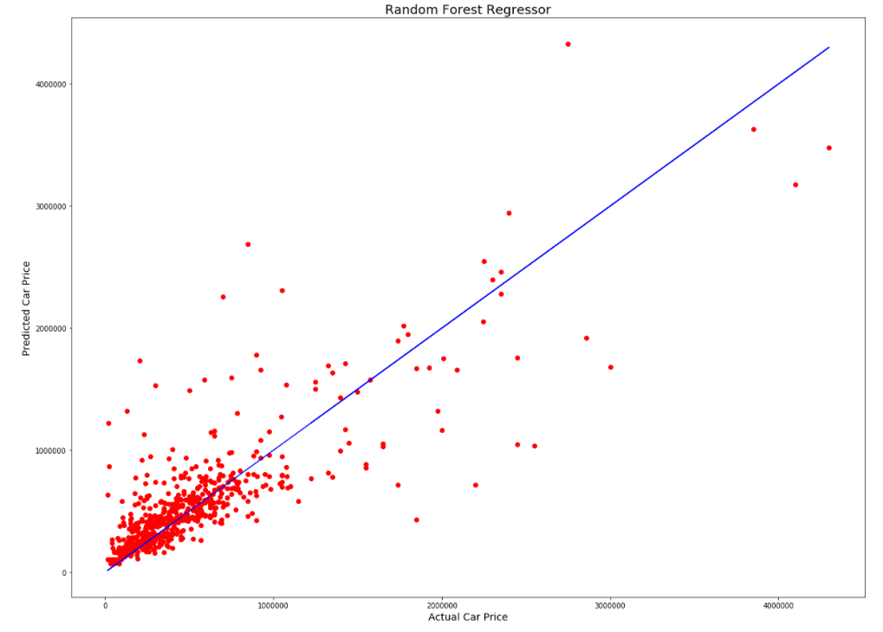
Finalising Model
As we saw after hyper parameter tuning with gridsearchCV our random forest model had the highest accuracy, hence this will be the model that we will finalize.

Slide 20
Conclusion
In this project we learned about car resale market and how data science and machine learning can be so helpful in this field.
Using predictive modeling and EDA we can determine which factors impact the market and which factors can be helpful in determining the prices.
After treating outliers, getting rid of redundant columns and other preprocessing, we manage to build a model which will give us fairly accurate results.

